Slide 1
Module 3: Mathematical Physics II

Slide 2
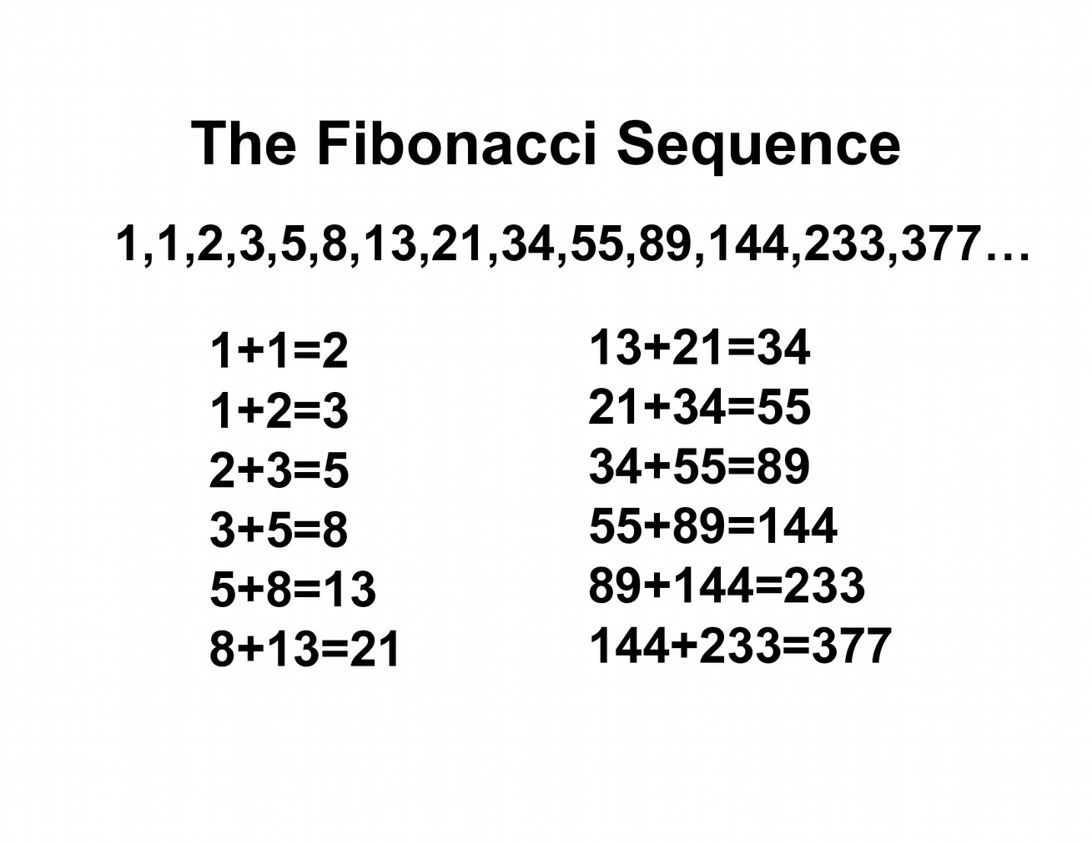
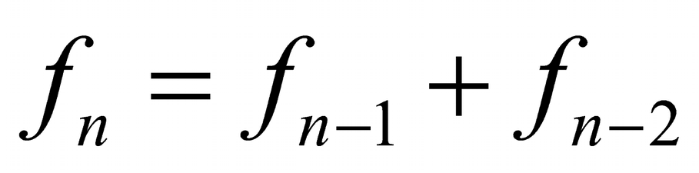
Sequential numbers
A sequence is a collection of elements with a particular order.
Elements of a sequence can be related to each other, and are often defined using recursion.
Sequences can be finite or infinite.
Sequence can be defined as a function.

Slide 3
Random numbers
A random number is a number chosen as if by chance from some specified distribution.
Such numbers are independent, having no correlations between successive numbers.

Slide 4
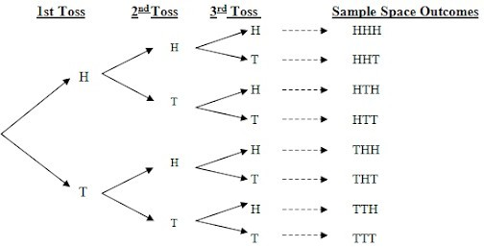
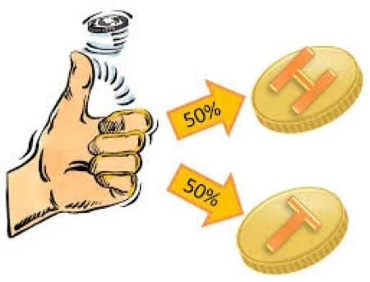
Probability
Probability is the possibility of occurrence of an event or outcome.
Sample Space: In probability, the set of all possible outcomes is called the Sample Space. We will use S to represent the sample space. In terms of the language of sets, a sample space is a universal set and an outcome is an element of the universal set.

Slide 5
Probability
The classical probability P(A) for an event A is defined by the number of favorable results n, divided by the number of possible results m
P ( A ) = ^{n}
m
P ( A¯ ) =1− ^{n}
Probability of complementary event
m
The statistical definition of the probability for an event A is given by:
P ( A ) =lim ^{n}
m→∞ m

Slide 6
Random numbers
Random numbers generated in the computer are pseudo-random numbers.
A pseudo-random number is a number generated with the help of a deterministic algorithm, however, it shows a behavior as if it were random.
A random number generator will have to comply with following criteria
Produce pseudo-random numbers whose statistical properties are as close as possible to those of real random numbers.
Have a long period: It should generate a non-repeating sequence of random numbers which is sufficiently long for computational purposes.
Be reproducible in the sense defined above, as well as re-startable from an arbitrary break-point.
Be fast and parallelizable: It should not be the limiting component in simulations.

Slide 7
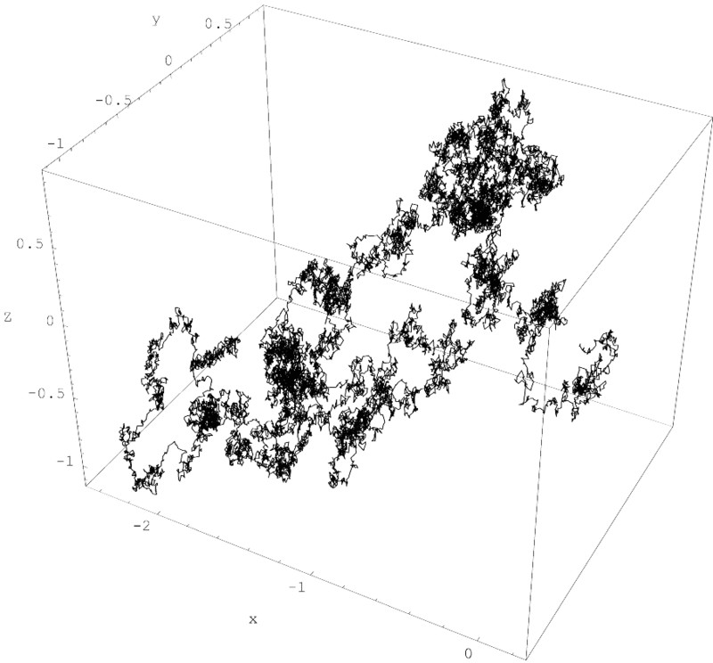

Randomness
Randomness: It is the lack of predictability of events, i.e., there is no pattern involved.
A random process is non- deterministic.

Slide 8
Random variable
A random variable is a variable whose value is unknown or a function that assigns values to each of an experiment's outcomes.
A random variable can be either discrete (having specific values) or continuous (any value in a continuous range).
The use of random variables is most common in probability and statistics, where they are used to quantify outcomes of random occurrences.
Risk analysts use random variables to estimate the probability of an adverse event occurring.

Slide 9
Random variable
A random variable is a functional whose value is assigned to the outcome of some random process.
For an event ω, random variable can be defined as X(ω)
⟨ X ⟩=∑ X (ω) p (ω)
Expectation value of X
Probability of event ω
σ =√⟨ X ² ⟩−⟨ X ⟩²
var ( X )=⟨ X ² ⟩−⟨ X ⟩²
Standard deviation

Slide 10
Random variable
In a random process, to ascertain the outcome of an event or to determine the <X>, multiple set of observations are utilized
x=⟨ X ⟩
For a set of observations x_{i} where i = 1; 2; ........ ; N
N
1
N
∑
i=1
x=
x
¯
i

Slide 11
Central limit theorem
Let X₁, X₂, X₃, .........., X_{n} are the n random samples with mean μ and variance σ
2
Then the limiting from of the distribution
n
∑ X_{i}−μ
Z =
i =1
n
√nσ²
tends to be normal.

Slide 12
Central tendencies and dispersion
Central tendency is single value that describes the set of data by identifying the central position of the data set.
In statistics, this is the typical value of a probability distribution.
1
n
n
∑
i=1
a₁ +a₂+a₃ +.....+a_{n}
A=
a =
Arithmetic mean
i
n
n
∑ w_{i} f _{i}
_{A=} i=1
Weighted arithmetic mean
n
∑ w_{i}
i =1

Slide 13
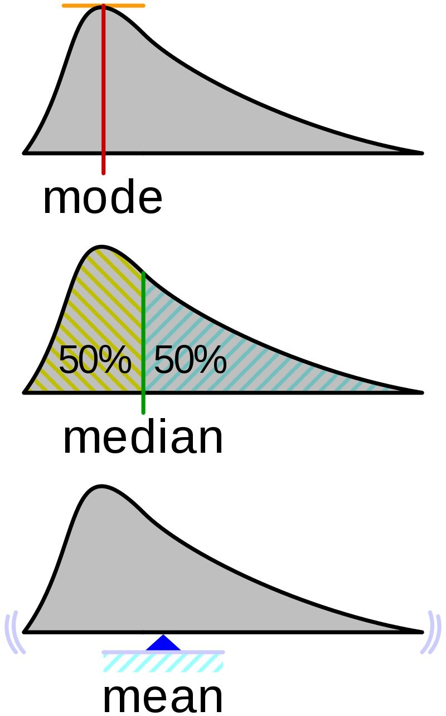
Central tendencies and dispersion
Median: It is the positional value that
divides the distribution in two equal parts.
1, 2, 3, 4, 5, 6, 7, 8, 9
Median
1, 2, 3, 4, 5, 6, 7, 8, 9, 10
Median = (5+6)/2
Mode: It is typical value around which distribution is concentrated or most frequent value in the data set.
1, 3, 6, 6, 6, 6, 7, 7, 12, 12, 17

Slide 14
1.Find the mean of the marks (out of 15) obtained by 20 students.
12 10 5 8 15 5 2 8 10 5 10 12 12 2 5 2 8 10 5 10
2.If the mean of the following data is 20.2, find the value of k
xi 10 15 20 25 30 fi 6 8 20 k 6

Slide 15
Central tendencies and dispersion
Variance: It is a measurement of the spread between numbers in a data set.
n
∑
( x −x)
2
¯
i
_{S}2₌ i=1
n−1
Standard deviation: It measures the dispersion of a data set relative to its mean.
√^{i=1} n−1
n
∑
¯
2
( x −x)
σ=√S²=
i

Slide 16
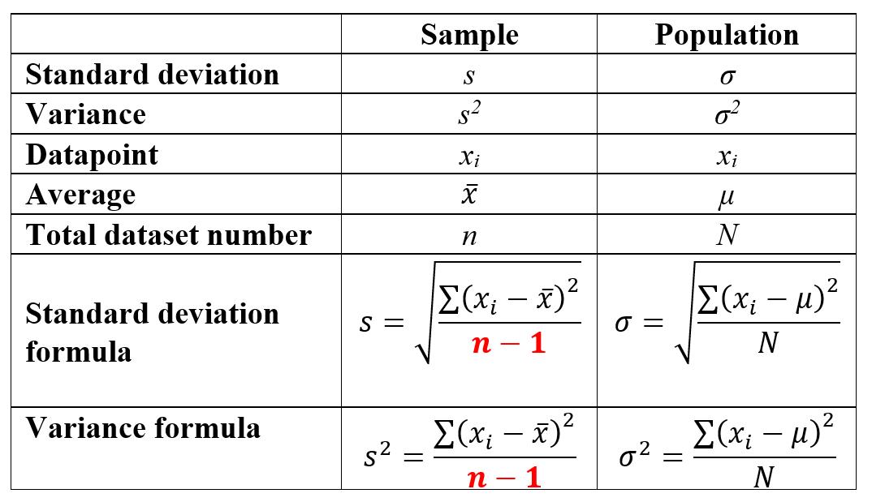

Slide 17
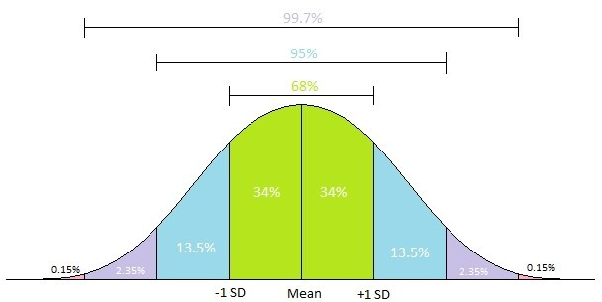
Central tendencies and dispersion

Slide 18
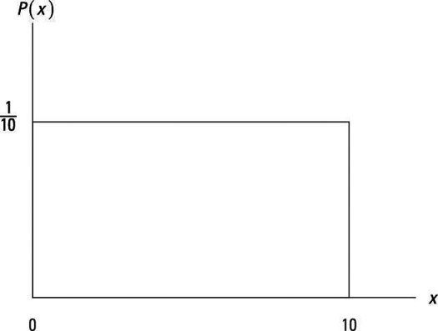
Frequency distribution
Probabiltiy density function : It is a function that provides the relative likelyhood of the random variable at that given point.
¹ for a≤x≤b b−a
0 elsewhere
P ( x )=
_{¯x=} a+b
2
_{σ}2₌ b−a
12
Continious unifrom distribution

Slide 19
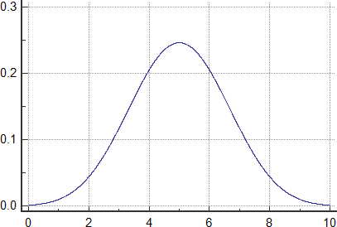
Frequency distribution
P ( x )= ^{n!} p^{x} q^{n− x}
(n−x )! x!
¯x=np
σ²=np (1− p)
Binomial distribution

Slide 20
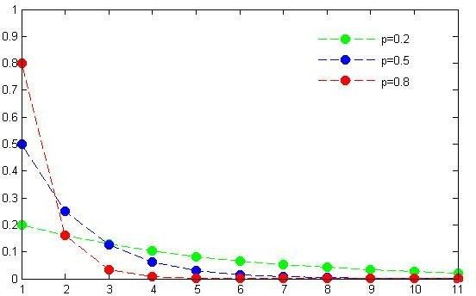
Frequency distribution
P ( x )=(1− p)^{x−1} p
_{¯x=} 1
p
_{σ}2₌1− p
_{p}2
Geometric distribution

Slide 21
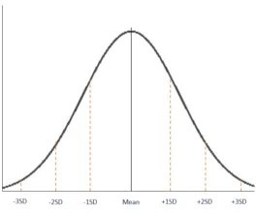
Frequency distribution
−1 x −μ ²
σ
)
P ( x )= ¹ e ^{2 π (}
σ √2 π
¯x=μ σ²=σ²
Normal distribution

Slide 22
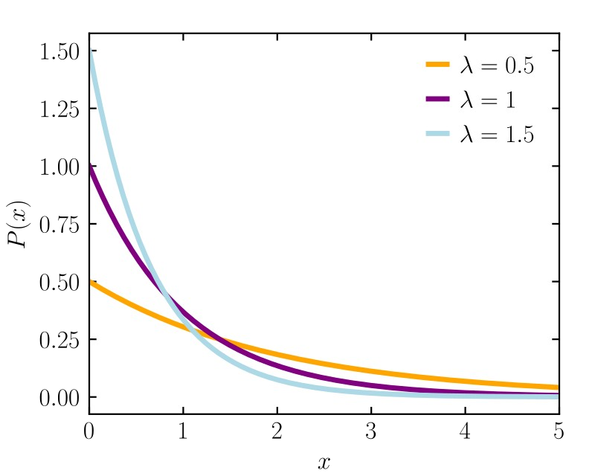
Frequency distribution
P ( x )=λ e^{−λ x}
_{¯x=} 1
λ
_{σ}2₌ 1
_{λ}2
Exponential distribution

Slide 23
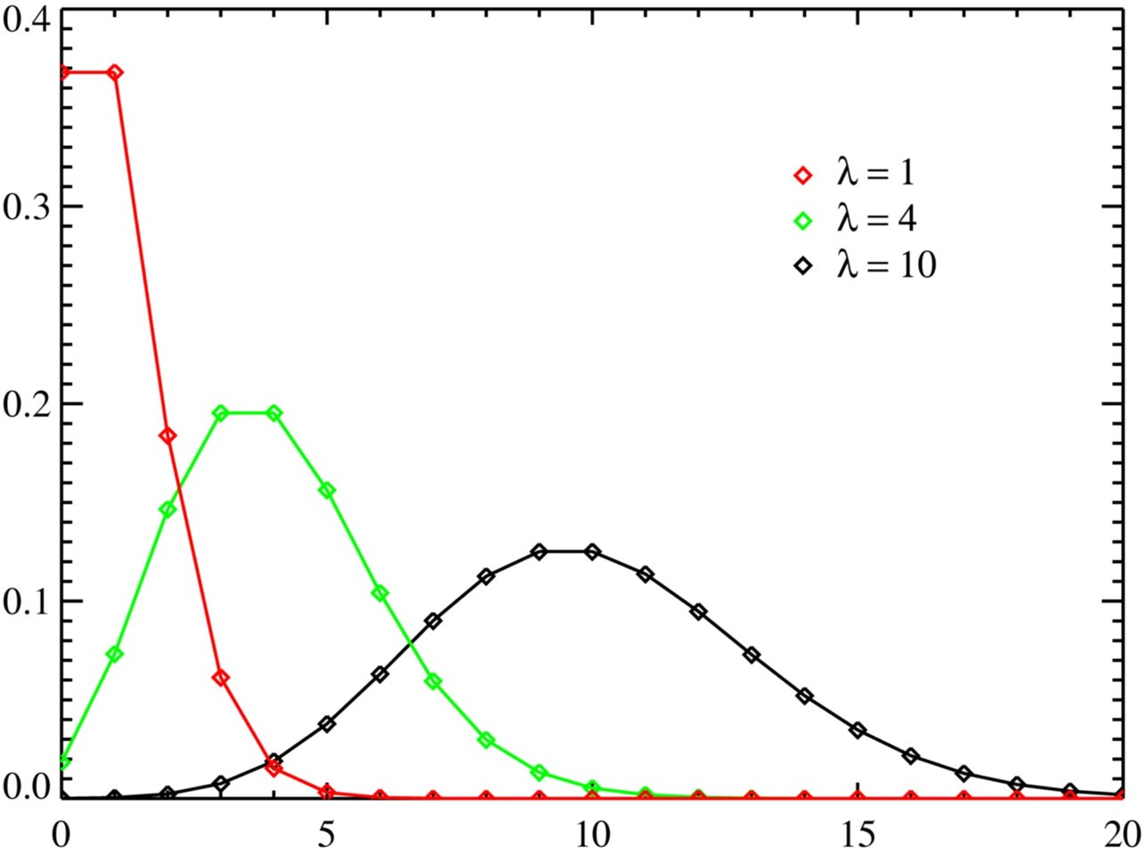
Frequency distribution
_{λ}x _{e}−λ
P ( x )=
x!
¯x=λ
σ²=λ
Poisson distribution

Slide 24
Error analysis
Errors are inevitable in computer simulations.
When simulating a phenomena, error can occur due to humans or computer
a.Approximation errors: This arises due to the simplification of mathematical functions, in order to solve them in computers. This includes replacement of infinite series by finite sums, infinitesimal intervals by finite ones, and variable functions by constants.
∞
_{∑(−1)}n _{x}2 n+1
sin ( x)= ^{n=0}
(2 n+1)! sin ( x)+ζ( x , N )
N
_{∑(−1)}n _{x}2 n +1
≈ n=0
(2 n +1)!
For every approximation increases.
reasonable approximation, the error should decrease as N

Slide 25
Error analysis
b.Round-off errors: This is the imprecision arising from the finite number of digits used to store floating-point numbers.
The overall round-off error accumulates as the computer handles more numbers, that is, as the number of steps in a computation increases, and may cause some algorithms to become unstable with a rapid increase in error.
¹ =0.33333333
3
Computer representation x_{c} of the exact number x is
x_{c}=x (1+ϵ_{x} )
^{ϵ}x ^{=ϵ}approx ^{+ϵ}roundoff

Slide 26
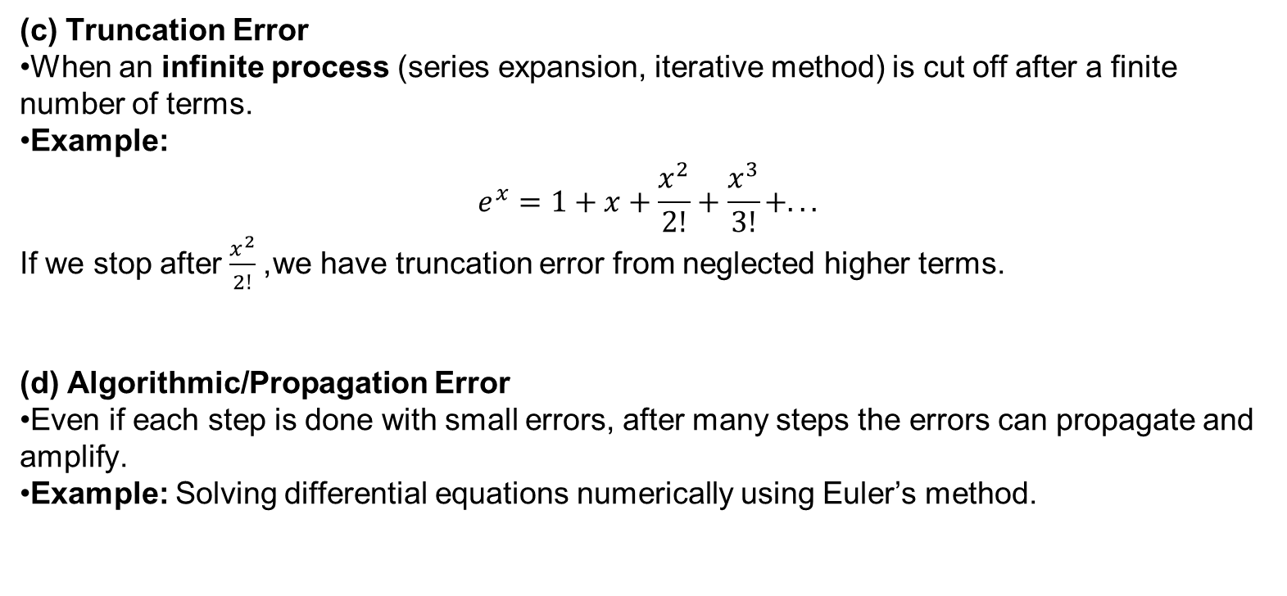
(c) Truncation Error
When an infinite process (series expansion, iterative method) is cut off after a finite number of terms.
Example: $e^{x}=1+x+\frac{x^{2}}{2!}+\frac{x^{3}}{3!}+...$ If we stop after $\frac{x^{2}}{2!}$, we have truncation error from neglected higher terms.
(d) Algorithmic/Propagation Error
Even if each step is done with small errors, after many steps the errors can propagate and amplify.
Example: Solving differential equations numerically using Euler’s method.

Slide 27
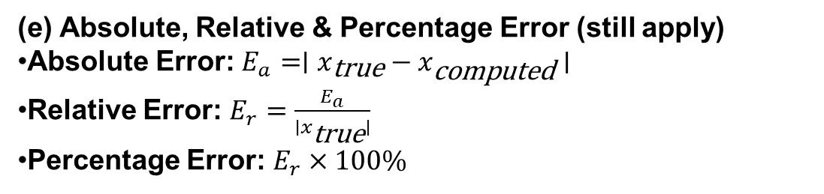
(e) Absolute, Relative & Percentage Error (still apply)
Absolute Error: $E_{a}=∣x_{\text{true}}−x_{\text{computed}}∣$
Relative Error: $E_{r}=\frac{E_{a}}{∣x_{\text{true}}∣}$
Percentage Error: $E_{r}×100\%$

Slide 28
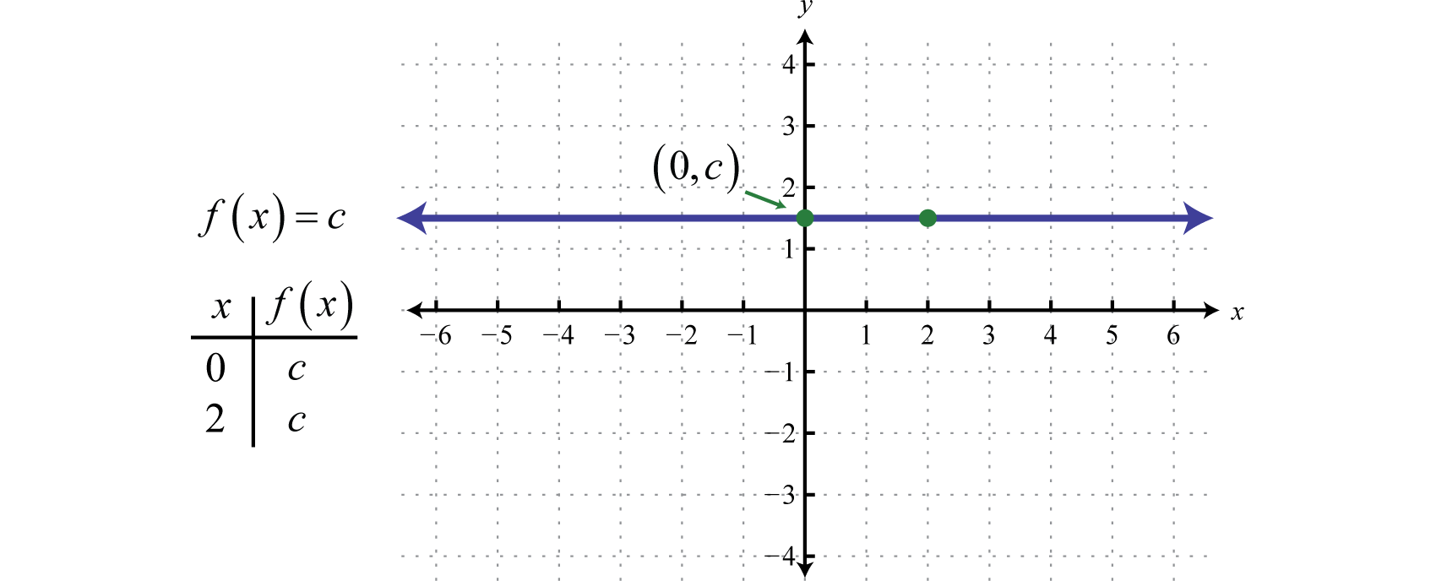
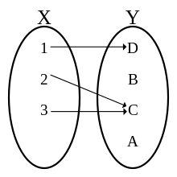
Simple functions
Function: It is a relationship between two sets.
y ---> {x}
Domain
Range

Slide 29
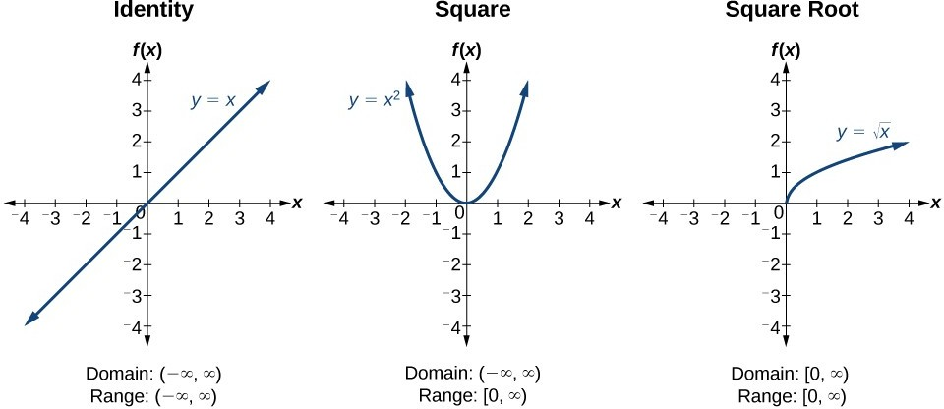
Simple functions

Slide 30
Simple functions
Find the domain and range of the functions
y= ¹ −5
x−3
x²−3 x−4
y=
x +1

Slide 31
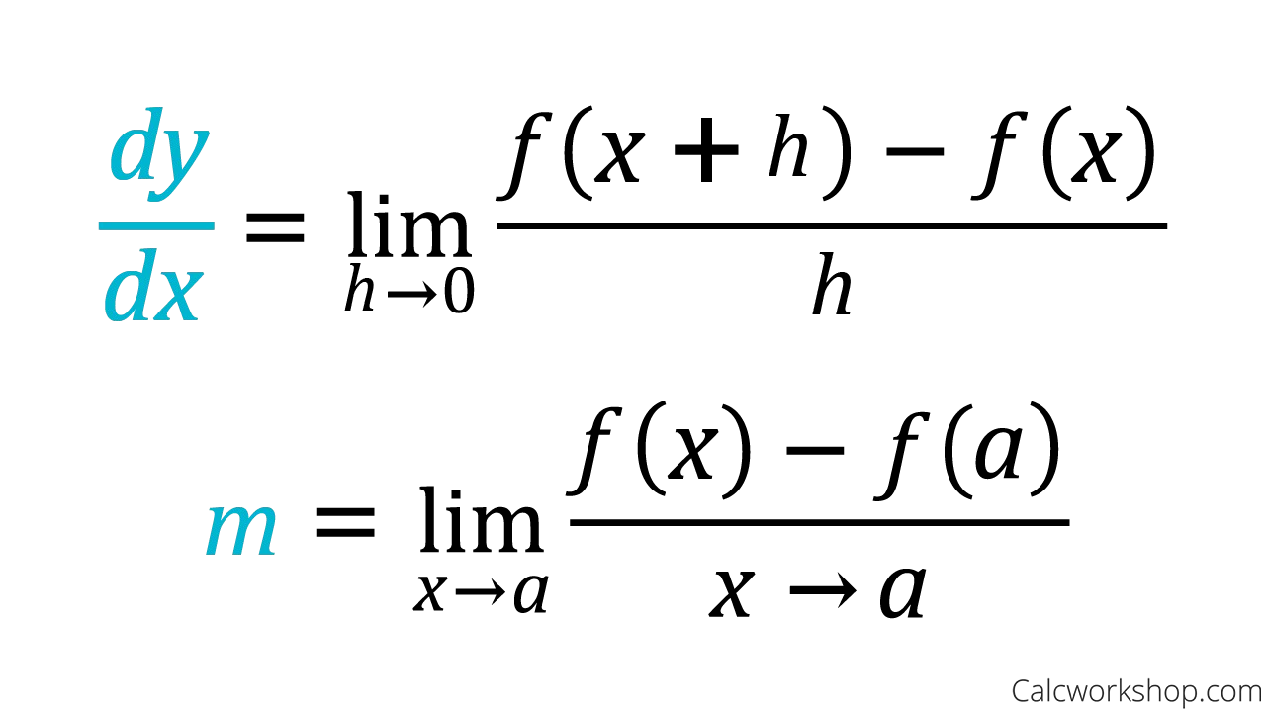
Derivative
Derivative of a function f(x) is defined as
Find the derivative of
f ( x)=2 x² +3 x−5 at x=−1
f ( x)=sin( x)

Slide 32
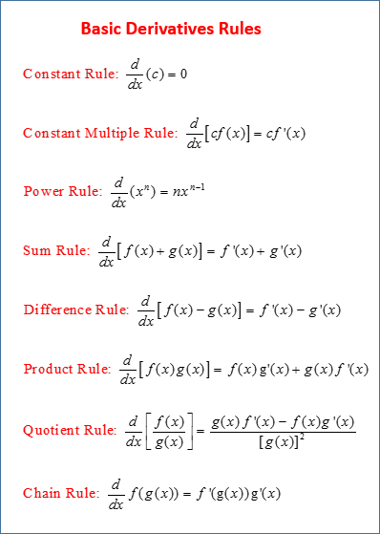
Derivative
Prove the following
Power rule
Product rule
Quotient rule

Slide 33
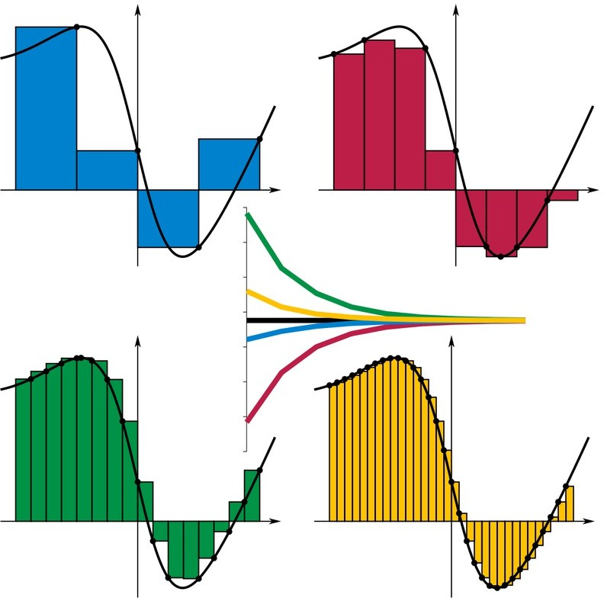
Integral
It is the inverse process of differentiation.
_{f ( x )=} dF ( x)
dx
∫ f ( x) dx=F ( x)+C
n−1
∫ f ( x) dx=∑ f (t ₁)( x_{i+ 1}−x_{i} )
i=0

Slide 34
Integral
Integrate the following
∫ dx
1+tan ( x)
∫sin³ ( x )cos² ( x) dx

Slide 35
Numerical differentiation
_{f ' ( x )=lim} f ( x+h)−f ( x)
Forward difference
h
h →0
_{f ' ( x )=lim} f ( x)−f ( x−h)
Backward difference
h
h →0
_{f ' ( x )=lim} f ( x+h)−f ( x−h)
Central difference
2 h
h →0

Slide 36
Numerical differentiation
Calculate the first derivative of cos(x) at x = π/3 for
h = 0.1
h = 0.01
h = 0.001
h = 0.0001
Also calculate error in each case.
h | forward | Error forward | backward | Error backward | central | Error central
0.1
0.01
0.001
0.0001

Slide 37
(cos(x+h) -cos(x))/h, x=pi/3
a) 0.1
f’_first_principle (x=pi/3) = (cos(pi/3+0.1) – cos(pi))/0.1
-0.88956192323
f’_direct(pi) = -sin(pi/3) = 3^{0.5}/2 = -0.86602540378 Error = f’_direct(x=pi/3) - f’_first_principle (x=pi/3)
= -0.86602540378 + 0.88956192323
= -0.02353651945

Slide 38
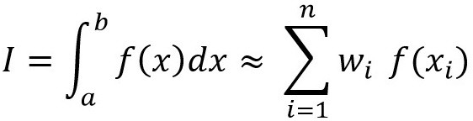
Numerical integration
1
Integrate the following ∫cos ( x) dx for w_{i}
0.1
0.01
0.001
0.0001
0
Also calculate error in each case.
1
10
∫cos ( x) dx=w ∑ cos( x_{i} )=w∗(cos (0)+cos(0.1)+cos(0.2)+cos(0.3)+....+cos (0.9))
0
i=1
1
10
∫cos( x) dx=w ∑ cos( x_{i} )=w∗(cos (0.1)+cos(0.2)+cos (0.3)+....+cos(1.0))
0
i=1
1
10
∫cos ( x) dx=w ∑ cos( x_{i} )=w∗(cos (0)+cos(0.1))/ 2+(cos(0.1)+cos (0.2))/ 2+..
0
i=1

Slide 39
∫ f ( x) dx=w∗∑ f ( x_{i})=w∗((f (a)+f (a +w ))/ 2+(f (a +w )+f (a +2 w ))/ 2+(f (a +2 w )+f (a +3 w ))/ 2+...)
b n
a
i=1
n−1
=w∗((f (a)+f (b))/ 2+∑ f ( x_{i} ))
i=1

Slide 40
Functions - Python
import matplotlib.pyplot as plt import numpy as np
x = np.linspace(-5,5,100)
y = 2*x+1
plt.plot(x, y, label='y=2x+1') plt.title('Graph of y=2x+1') plt.xlabel('x')
plt.ylabel('y')
plt.legend(loc='upper left') plt.grid()
plt.show()

Slide 41
Functions - Python
import matplotlib.pyplot as plt import numpy as np
fig = plt.figure()
x = np.linspace(-5,5,100)
plt.plot(x, 2*x+1, '-r', label='y=2x+1') plt.plot(x, 2*x-1,'-.g', label='y=2x-1') plt.plot(x, 2*x+3,':b', label='y=2x+3') plt.plot(x, 2*x-3,'--m', label='y=2x-3') plt.legend(loc='upper left') plt.show()

Slide 42
Functions - Python
import matplotlib.pyplot as plt import numpy as np
fig = plt.figure()
ax = fig.add_subplot(1, 1, 1) x = np.linspace(-5,5,100)
ax.spines['left'].set_position('center')
ax.spines['bottom'].set_position('center') ax.spines['right'].set_color('none') ax.spines['top'].set_color('none') ax.xaxis.set_ticks_position('bottom') ax.yaxis.set_ticks_position('left') plt.plot(x, 2*x+1, 'r', label='y=2x+1') plt.plot(x, 2*x-1,'g', label='y=2x-1') plt.plot(x, 2*x+3,'b', label='y=2x+3') plt.plot(x, 2*x-3,'k', label='y=2x-3') plt.legend(loc='upper left')
plt.show()

Slide 43
Functions - Python
import matplotlib.pyplot as plt import numpy as np
x = np.linspace(-2, 2, 100) y = x ** 2
fig = plt.figure(figsize = (10, 5)) plt.plot(x, y)
plt.show()

Slide 44
Functions - Python
import matplotlib.pyplot as plt import numpy as np
x = np.linspace(-6, 6, 50) y = np.cos(x)
plt.plot(x, y, 'b', label ='cos(x)')
plt.xlabel('x-axis') plt.ylabel('y-axis')

Slide 45
Functions - Python
import matplotlib.pyplot as plt import numpy as np
x = np.linspace(0, 1, 1000) y = np.exp(x)
plt.plot(x, y, 'b', label ='exp(x)')
plt.xlabel('x-axis') plt.ylabel('y-axis')

Slide 46
Functions - Python
import matplotlib.pyplot as plt import numpy as np
x = np.linspace(1, 100, 1000) y = np.log(x)
plt.plot(x, y, 'b', label ='ln(x)')
plt.xlabel('x-axis') plt.ylabel('y-axis')

Slide 47
Functions - Python
import matplotlib.pyplot as plt import numpy as np
x = np.linspace(1, 100, 1000) y = np.log10(x)
plt.plot(x, y, 'b', label ='log(x)')
plt.xlabel('x-axis') plt.ylabel('y-axis')

Slide 48
Central tendencies - Python
import numpy as np import statistics
data1 = [1, 3, 4, 5, 7, 9, 2]
x = statistics.mean(data1) print("Mean is :", x)

Slide 49
Central tendencies - Python
import numpy as np import statistics
from statistics import mean
data1 = [1, 3, 4, 5, 7, 9, 2]
print("Mean is :", mean(data1))

Slide 50
Central tendencies - Python
import numpy as np import statistics
data1 = [1, 3, 4, 5, 7, 9, 2]
print("Median of data-set is : ", statistics.median(data1)))

Slide 51
Central tendencies - Python
import statistics
set1 =[1, 2, 3, 3, 4, 4, 4, 5, 5, 6]
print("Mode of given data set is :", (statistics.mode(set1)))

Slide 52
Central tendencies - Python
import statistics
sample = [1, 2, 3, 4, 5]
print("Standard Deviation of sample is:" , (statistics.stdev(sample)))

Slide 53
Random numbers - Python
from numpy.random import rand for i in range(10):
print(rand())
from numpy.random import randint for i in range(10): print(randint(0,10))

Slide 54
Random numbers - Python
from numpy.random import rand
l=[]
for i in range(10): l.append(rand())
print(l)
plt.plot(l) plt.show()

